Slide 1
HTML5 and CSS3
Colour on the Web

Slide 2
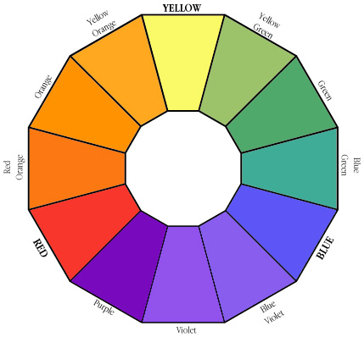
Colour Theory
Understanding colour theory will help you to understand how colour works on Web pages.
And one of the first places to start learning colour theory is with the colour wheel.
Sir Isaac Newton first put together a circular diagram of colours in 1666.
This colour wheel allows you to see groupings of colours that are harmonius together and other colours that might clash.

Slide 3
Primary Colours
The primary colours are RED, YELLOW, and BLUE.
These colours, in traditional colour theory, cannot be formed by mixing any other colour.
All other colours are derived by combinations of these colours. They are represented in HTML as:
Red: #ff0000 or #f00 in CSS
Yellow: #ffff00 or #ff0 in CSS
Blue: #0000ff or #00f in CSS

Slide 4
Secondary Colours
Secondary colours are ORANGE, GREEN, and PURPLE.
These colours are the combination of red and yellow (orange), yellow and blue (green), and blue and red (purple).
They are represented in HTML as:
Orange: #ff9900 or #f90 in CSS
Green: #00ff00 or #0f0 in CSS
Purple: #ff00ff or #f0f in CSS

Slide 5
Tertiary Colours
Tertiary colours are YELLOW-ORANGE, RED-ORANGE, RED-PURPLE, BLUE-PURPLE, BLUE-GREEN, and YELLOW-GREEN.
These are the combinations of the secondary colours. They are represented in HTML as:
Yellow-Orange: #ffcc00 or #fc0 in CSS
Red-Orange: #ff6600 or #f60 in CSS
Red-Purple: #cc00cc or #c0c in CSS
Blue-Purple: #9900ff or #90f in CSS
Blue-Green: #00cccc or #0cc in CSS
Yellow-Green: #ccff00 or #cf0 in CSS

Slide 6
How to combine these colours
There are certain colours that look good together, while other colours look so painful you have to click away before they burn your eyes.
And while you might recognize these combinations when you see them, there is a theory based on the colour wheel as to which colours will look nicest together.

Slide 7
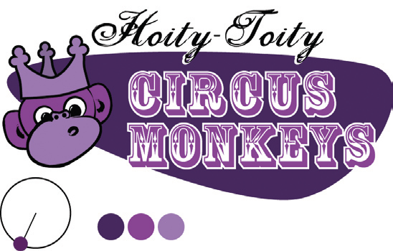
Monochromatic Colour Scheme
Consists of a single base colour and any number of tints or shades of that colour.
Here’s our regal monkey, where you can see a monochromatic colour scheme in purple.

Slide 8
Monochromatic Colour Scheme
Another example of a mostly monochromatic colour scheme comprising various shades and tints of the colour green.

Slide 9
Monochromatic Colour Scheme
When your branding and identity efforts start with a colour, a monochromatic colour scheme is an obvious choice.
The guys at the consulting and design firm Blue Flavor took this idea and ran with it.
Rather than choosing colours to suit the brand, they’ve taken the colour blue and made it into their brand for a uniquely simple colour scheme.

Slide 10
Monochromatic Colour Scheme
The colour blue was taken and made it into a brand for a uniquely simple colour scheme.

Slide 11
Monochromatic Colour Scheme
A colour scheme using only black, white, and shades of grey are merely shades and tints of grey.

Slide 12
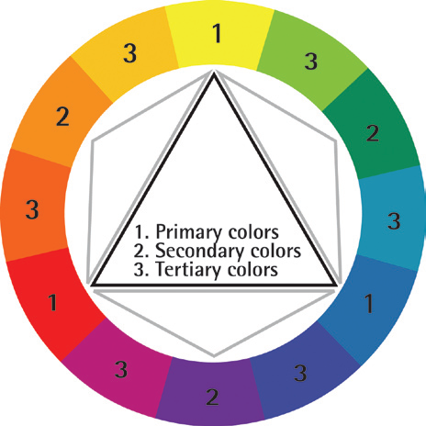
Analogous Colour Scheme
These are the colours that sit next to each other on the colour wheel.
For example: green, yellow-green, and yellow; or red, red- orange, and orange.
These colours often work well together but if too close in value they can appear washed out or not have enough contrast.

Slide 13
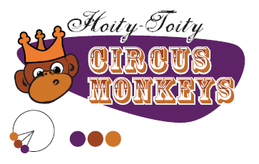
Analogous Colour Scheme
Getting back to our hoity-toity monkeys example from the Monochromatic Colour Scheme we’ve taken their purple and made it feel warm with some orange tones.

Slide 14
Analogous Colour Scheme
Orange is a good colour to use to promote food and maroons and burgundy's have a very rich feeling to them.
The site for Regine’s Patisserie takes advantage of the psychological effects of both of those colours.

Slide 15
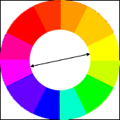
Complementary Colour Scheme
Complementary colours are those colours that are opposite one another on the colour wheel.
Complementary colours printed side by side can cause visual vibration making them a less than desirable combination.
However, separate them on the page with other colours and they can work together.

Slide 16
Complementary Colour Scheme
By using colours that are opposite one another, you create colour schemes that have high contrast and so are brighter and more vivid.
Some contrasting colours are:
red and green or
blue and orange.

Slide 17
Complementary Colour Scheme
The violet of this logo is used throughout the site, and is balanced by the use of a neutral yellow.

Slide 18

Common Complementary Pitfalls
Since complementary colours are so different from each other in so many ways, they can cause an effect known as simultaneous contrast when placed together:
Each colour makes the other appear more vibrant and dominant. This effect is actually what makes complementary colour schemes so successful at moving visitors’ eyes around a composition.
However, it can be horribly painful when complementary colours are used in a foreground–background relationship.

Slide 19
Common Complementary Pitfalls
Another common pitfall is to choose colours that are not quite directly opposite one another on the colour wheel, yet are not close enough to be analogous colours.
These combinations are known as discordants because the colours will often clash with one another, causing viewers to feel discord.

Slide 20
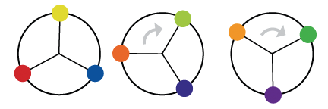
Triad Colour Scheme
By placing an equilateral triangle on the colour wheel, you can create colour schemes that have a lot of life to them.
The most basic colour triad is the three primary colours: red, yellow, and blue.
But others are: green, purple and orange, or yellow-orange, blue-green, and red-purple.

Slide 21
Colour Symbolism
When choosing the colours for your site, you need to first (as always) think of your audience.
Is it a global audience?
Is it primarily Western? Eastern?
Are they older? Younger?
Male? Female?
All of these things, and more can affect the colour choices for your site.
http://webdesign.about.com/od/color/a/bl_colorculture.htm
http://desktoppub.about.com/cs/color/a/symbolism.htm

Slide 22
How many Colours?
It is hard to give an exact answer to this question.
Too many colours will make the page feel too busy and it usually makes it harder for the viewer to find the information he or she wants. It is also more tiring to the eyes.
A page with too few colours, on the other hand, risks being seen as a bit boring, but this need not always be the case.
One commonly used rule in these matters is to use three colours.
Primary colour: This is the main colour of the page. It will occupy most of the area and set the tone for the design as a whole.
Secondary colour: This is the second colour on the page, and it is usually there to "back up" the primary colour. It is usually a colour that is pretty close to the primary colour.
Highlight colour: This is a colour that is used to emphasize certain parts of the page. It is usually a colour which contrasts more with the primary and secondary colours, and as such, it should be used with moderation. It is common to use a complimentary colour for this.

Slide 23


Colours and Text
Using the right contrast is especially important for text.
Using the wrong colours can decrease the readability drastically, and it will quickly tire the reader's eyes.
Black text on a white background has the highest readability.
Black and yellow is another combination which usually has a high readability, as do blue and white.
Green text on red and red text on green are particularly hard for many people to read.
A combination of red and blue creates a vibrating effect that can also make reading very difficult.

Slide 24
Cool Links
http://www.colorsontheweb.com/colorwizard.asp
This colour wizard lets you submit your own base colour, and it automatically returns matching colours for the one you selected.
http://www.colorsontheweb.com/colorwheel.asp
This online tool will generate random colour combinations and display in sample designs.
http://www.colorsontheweb.com/colorcontrast.asp
The colour Contrast Analyser will tell you whether two colours meet the accessibility guidelines defined by the W3 consortium.
http://uxmovement.com/content/how-to-use-color-to-brand-your-website/

